Slide 1


POLICE
FEEDBACK SYSTEM
Presented by Code_Crewmates

Slide 2


KEY POINTS
INTRODUCTION
FEEDBACK PROCESS
About Feedback and its importance
How user can give feedback.
FEEDBACK MANAGEMENT
CONCLUSION
How admin and officers manage the feedback.
Overall conclusion

Slide 3


INTRODUCTION
A Police Feedback System is a mechanism that allows individuals to provide feedback on the conduct and performance of law enforcement agencies and officers. This system plays a crucial role in promoting transparency, accountability, and collaboration between the police force and the community. Here's an introduction to a Police Feedback System and how it can be beneficial for common people:
The primary purpose of a Police Feedback System is to establish a channel for citizens to share their experiences, concerns, and opinions regarding interactions with law enforcement. It aims to create a constructive dialogue between the police and the community, fostering mutual understanding and trust.

Slide 4
FEEDBACK PROCESS
SCAN QR
VERIFY YOURSELF THROUGH OTP
GIVE FEEDBACK
For giving the feedback, the user need to scan the QR presented in every police station which redirects them feedback page of police feedback system.
After successfully authentication ,the user redirects to feedback page where user can give feedback related to their services received.
For the feedback process the user have to verify themselves through OTP authentication.
SUBMIT

Slide 5




STEP 1: SCAN QR:

Slide 6

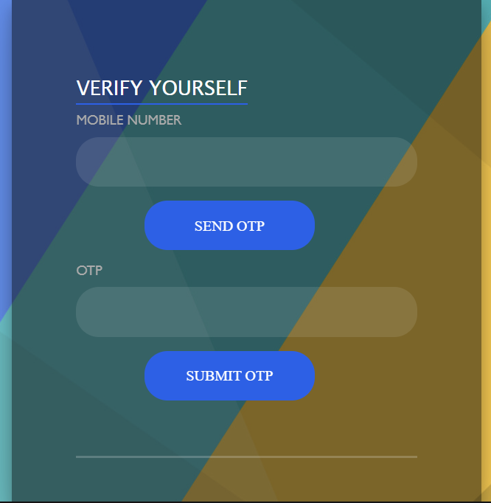

STEP 2: VERIFY YOURSELF:
1

Slide 7
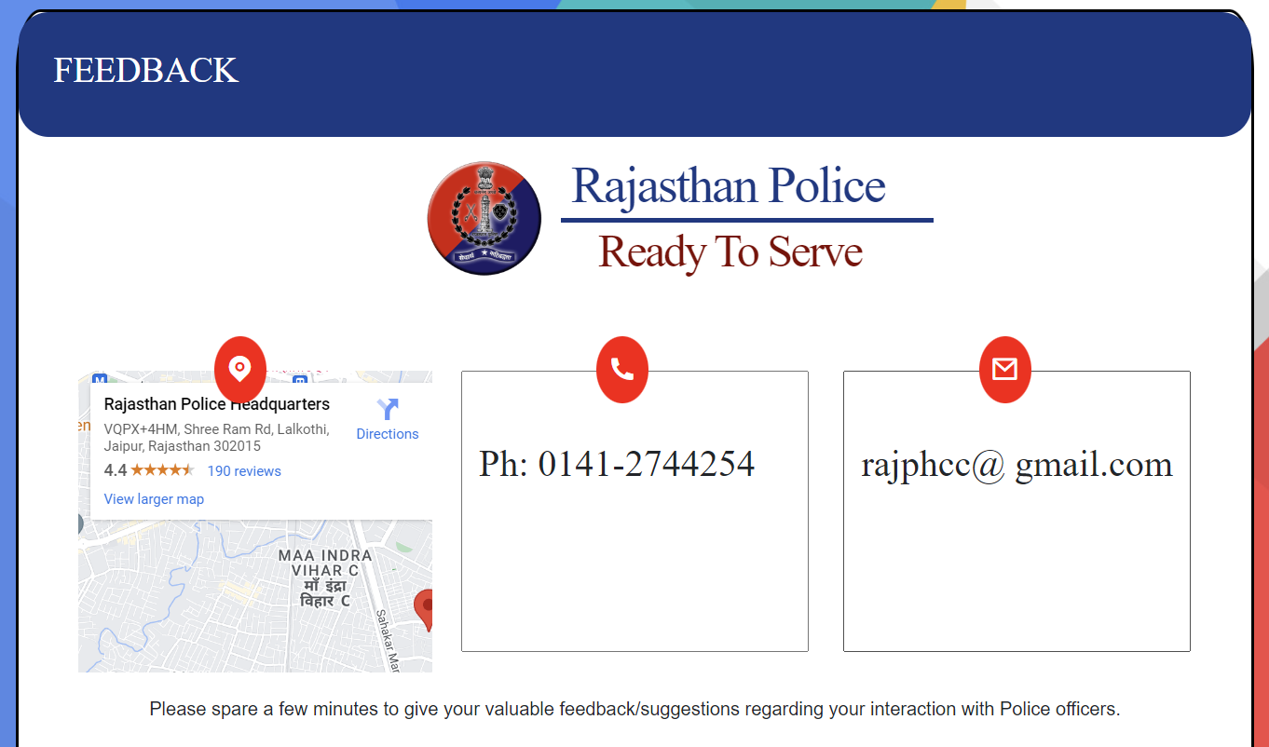
STEP 3: FEEDBACK PAGE:

Slide 8
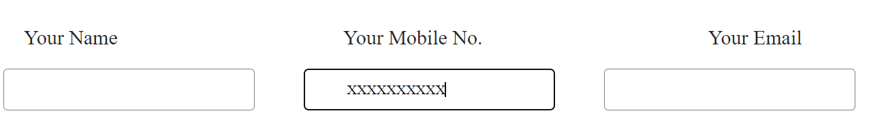

STEP 4: ENTER DETAILS:

Slide 9
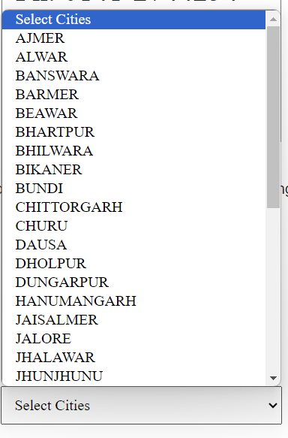
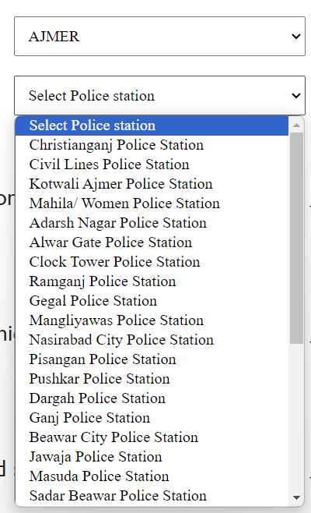

STEP 5: SELECT CITY AND POLICE STATION

Slide 10
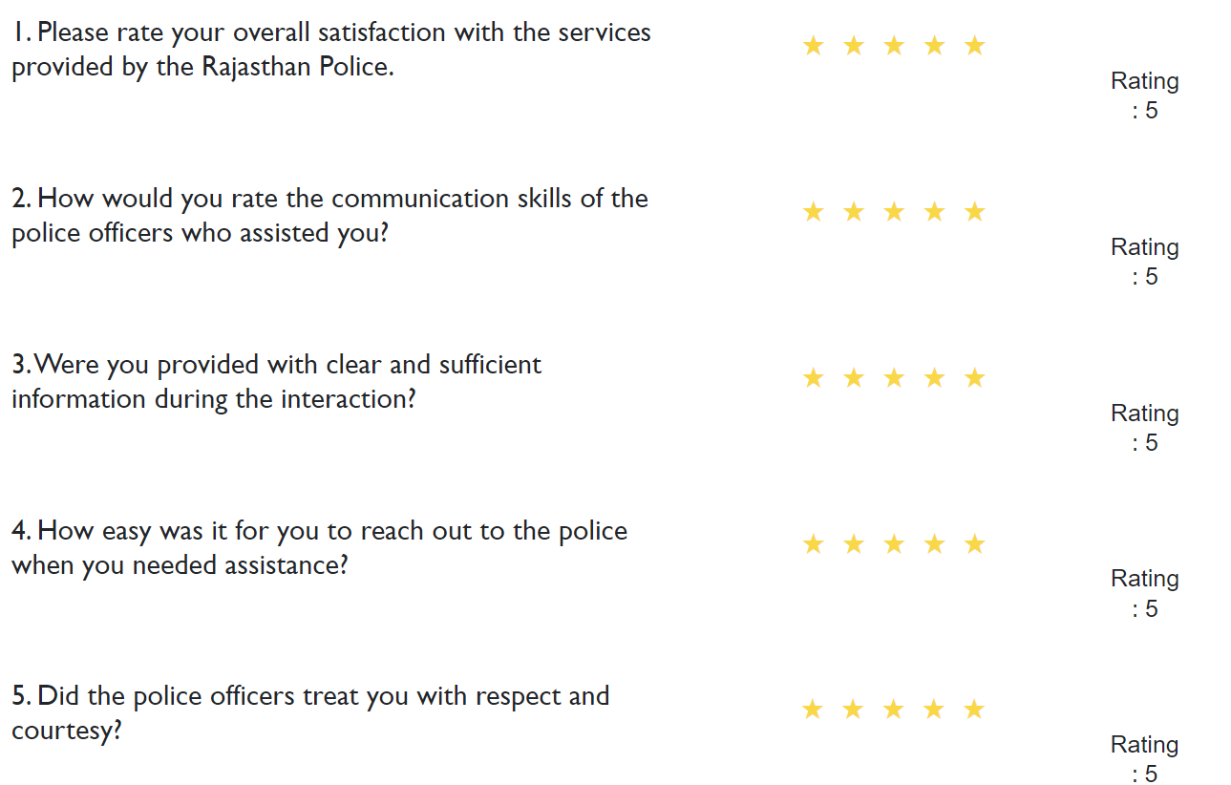
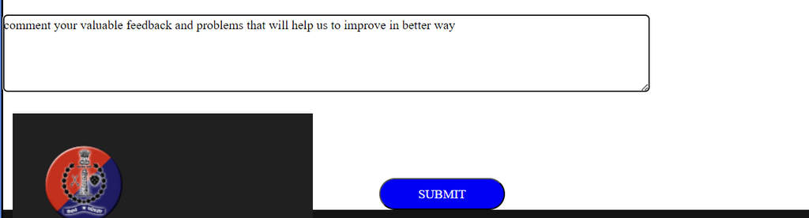
STEP 6: GIVE VALUABLE FEEDBACK AND RATINGS

Slide 11
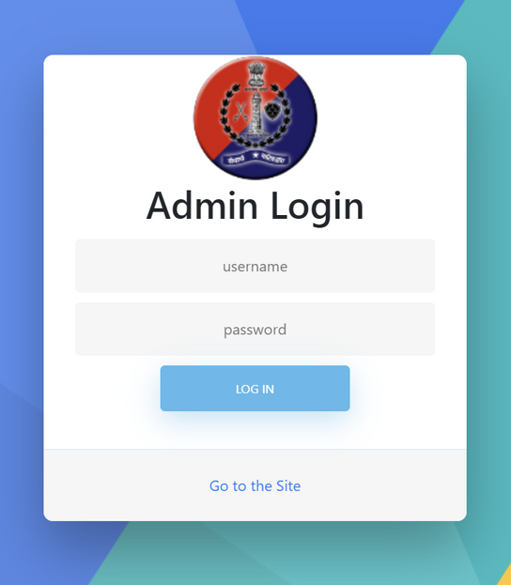
POLICE FEEDBACK MANAGEMENT
THE POLICE FEEDBACK SYSTEM IS MANAGED BY ADMIN AND THE AREA OFFICERS.
ADMIN
THE ADMIN HAVE ALL THE PRIVILEGES FOR MANAGING THE FEEDBACK JUST LIKE ADDING OFFICERS AND EDITTING OTHER DETAILS.

Slide 12
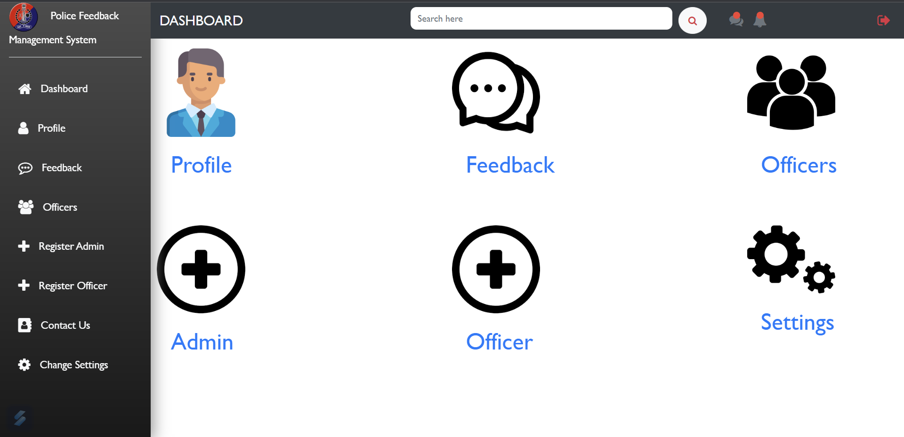
THE ADMIN CAN ACCESS ALL THE FEATURES LISTED IN THE DASHBOARD.

Slide 13
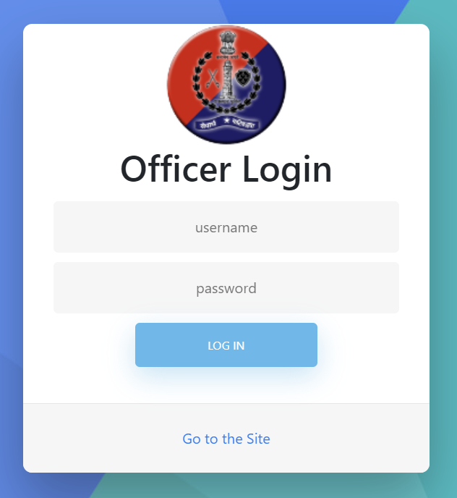
POLICE FEEDBACK MANAGEMENT
OFFICER LOGIN
THE OFFICER HAVE LESS PRIVILEGES THAN ADMIN AND CAN ACCESS FEEDBACK GUVEN BY THE USERS.

Slide 14
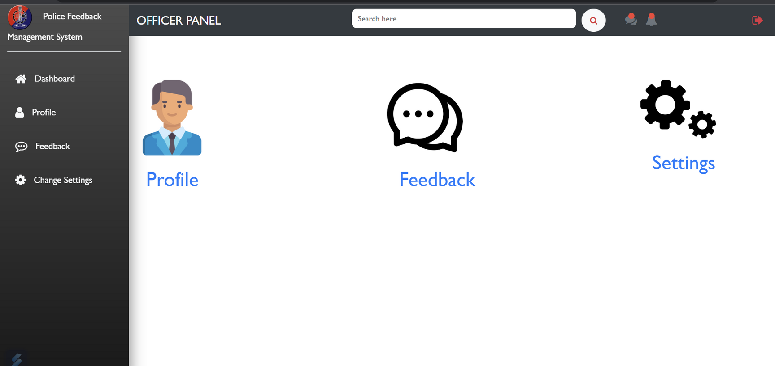
THE OFFICER CAN ACCESS THE FEATURES LISTED IN THE DASHBOARD.

Slide 15
CONCLUSION
IN CONCLUSION, A POLICE FEEDBACK SYSTEM IS A VITAL TOOL THAT CONTRIBUTES TO THE ENHANCEMENT OF LAW ENFORCEMENT SERVICES AND THE RELATIONSHIP BETWEEN POLICE AND THE COMMUNITY. BY PROVIDING A STRUCTURED PLATFORM FOR INDIVIDUALS TO EXPRESS THEIR OPINIONS, CONCERNS, AND EXPERIENCES WITH LAW ENFORCEMENT, THIS SYSTEM PLAYS A PIVOTAL ROLE IN FOSTERING TRANSPARENCY, ACCOUNTABILITY, AND MUTUAL TRUST

Slide 16
POLICE FEEDBACK SYSTEM
THANK YOU

